Slide 1


University of Sousse
Higher Institute of Computer Science and Communication Technologies
Of Hammam Sousse
Specification Book for a PFE project
Realized by:
Mohamed Amine Selmi
Field of Study:
Licence en Science de l’Informatique: Informatique et Multimédia
Internship realized in:
I.S.I.T.C.O.M
Address : Route principale N°1 4000 Hammam Sousse
Internship Period :
15/02/2024 - 31/05/2024
University year: 2023/2024
1

Slide 2
Summary
A. Introduction
University
Intern
Supervisor
B. Application overview
Challenges
Objectives
Technical specifications and features
Target Audience
C. Expected Deliverables
Developing a mobile application
Working Environment
Development Tools
2

Slide 3
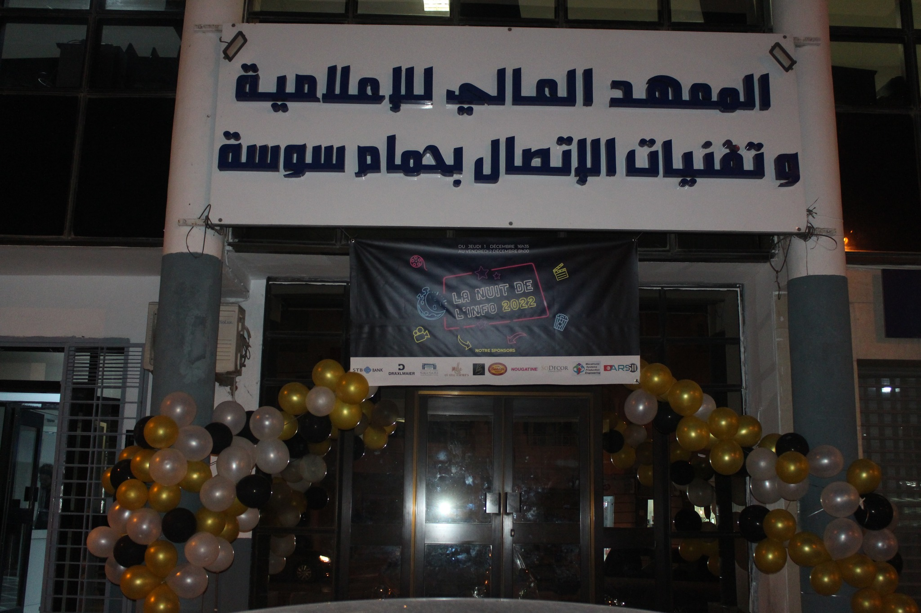
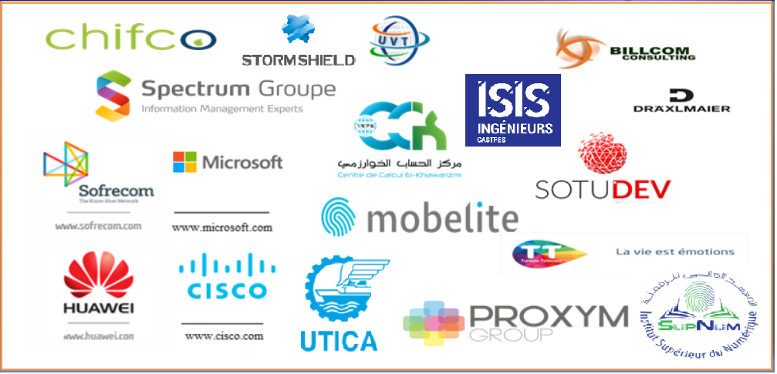
A. Introduction:
A.1 University:
Higher Institute of Computer Science and Communication Technologies of Hammam Sousse “I.S.I.T.C.O.M” was established in August 2001 by Decree No. 1912/2001 dated August 14, 2001.
92
30
1300
Professors
Administration
Students
Partnerships:
3

Slide 4
A.2 Intern:
Name: Mohamed Amine Selmi
Phone number: 23057592
Email address: MohamedAmineSelmi@outlook.com
A.3 Supervisor:
Name: Ajroud Amen
Phone number:
Email address: amen.ajroud.isitcom@gmail.com
B. Application Overview:
B.1 Challenges:
There exists multiple messaging apps, which create a problem of fragmented communication. This app seeks to provide users with a single platform to connect, share messages and stay in touch, avoiding the need to use multiple apps.
B.2 Objectives:
Creating a Mobile Application for user communication and message exchange. Through the App users can:
-Exchange messages: Text and Media.
-Perform audio and video calls.
-Receive real-time notifications.
-Invite Friends to form a group chat.
4

Slide 5








B.3 Technical specifications and features:
Sending Messages
Message encryption
Making Calls
Notification Push
Creating group chats
Multiple themes and colors
Message Search
Offline Sync
Type of Application:
Mobile application installed on a smartphone or tablet, tailored to each operating system and compatible with iOS and Android.
Application Availability:
The application should be available on the Google Play Store and the Apple Store to reach the widest audience possible.
Project Scope:
The application will be available in two languages: French and English.
5

Slide 6
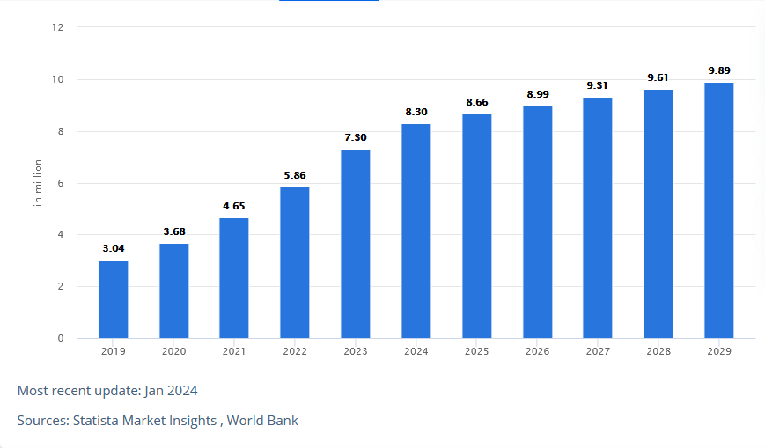
B.4 Target audience:
This application is designed for public usage and only requires a mobile phone and internet connection . According to a World Bank study, The number of Tunisians satisfying those requirements is 9.89 million, 80% of the population.
C. Expected Deliverables:
C.1 Developing a mobile application:
Developing a mobile application that allows for instantaneous communication between users.
C.2 Working Environment:
-Laptop
-Mobile Phone
-Internet connection
6

Slide 7
C.2 Development Tools:
-Flutter
-Django
-Websocket /Socket.io
-Firebase/SQL
7

